Slide 1
Continuous Integration Make your development life simpler

Slide 2

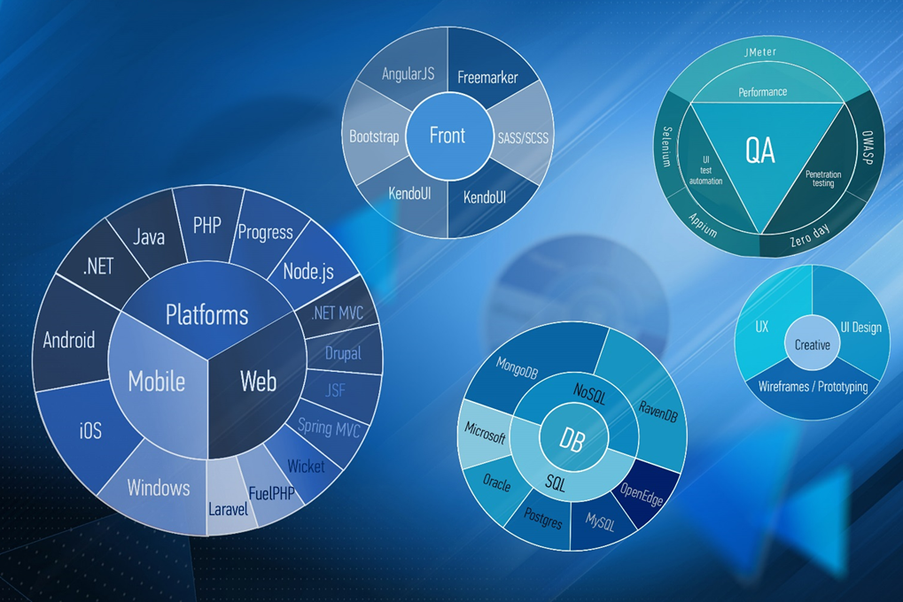

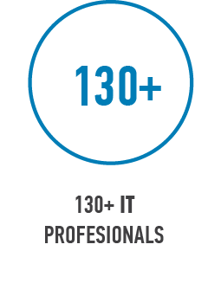








About Baltic Amadeus
Over 27 years of Reliable IT solutions
Technologies
Main activities

Slide 3
Agenda
Introduction to Continuous Integration
Demo: do it yourself
What‘s next?

Slide 4
Introduction to Continuous Integration

Slide 5
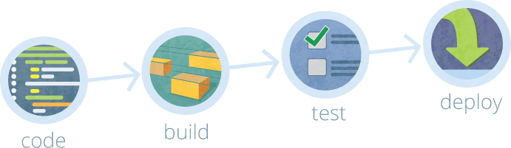
Continuous Integration methodology
Introduced as part of XP, now used more widely;
Intended to notice potential problems ASAP;
Merge all developer working copies to a shared mainline;
Automated builds and tests for every commit.
Notes:
No single definition

Slide 6
Why do we need Continuous Integration?
Notes:
Viskas faina, bet kam viso to reikia?

Slide 7

Bugs become more expensive over time
Why do we need Continuous Integration?
Fix problems ASAP;
Save time;
Avoid problems in production.
Notes:
Skirtumas tarp 10 min darbo ir pusdienio. Rizika dėl bug‘ų produkcijoj.
Dabar gal reikia tik pakeisti metodo pavadinimą; po mėnesio galbūt kažkam reikės viską iš naujo analizuoti

Slide 8


Shared development environment
Why do we need Continuous Integration?
„But it works on my machine...“ – every developer ever;
Test code on environment similar to production;
Maintain the same environment with testers and managers.
Notes:
Bendras auto ir manual test environment garantuoja, kad visi gali išmėginti pakeitimus vienodom sąlygom. Ant aplinkos (aplinkų), kurios simuliuoja PROD.
Dažnai mum patiem yra buvę, kad su testuotojais/PO nesuderinam
Kai visi turim savo dev environment, tai galim turėti kažką, ko bendram serve nėr. Arba tiesiog užmiršt sukomitinti.

Slide 9
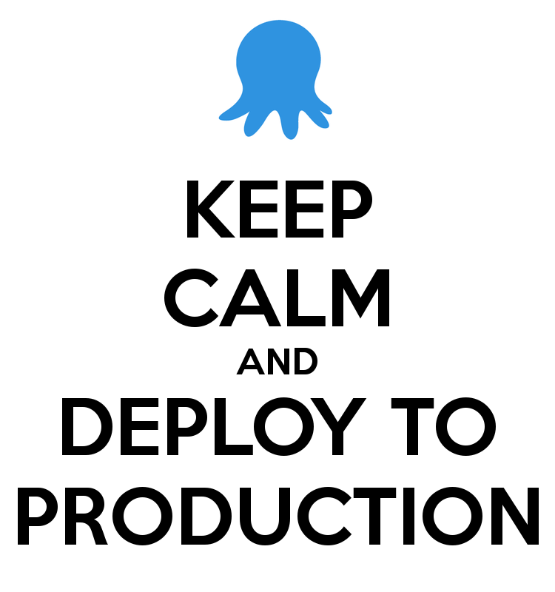
Simple deployment
Why do we need Continuous Integration?
Deploy to different environments with one click;
Maintain as many environments as needed;
If all works well – deploy to production with one click.
Notes:
Tęsiant tą pačią mintį. Nebūtina turėti admin žinių, tereikia speustelti mygtuką ir bus sukelta testuotojams, PO, dev, o gal ir į DEMO/UAT

Slide 10
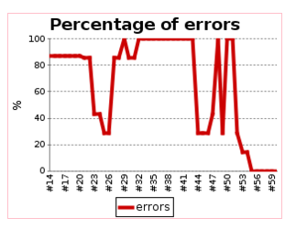
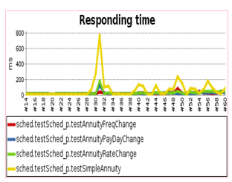
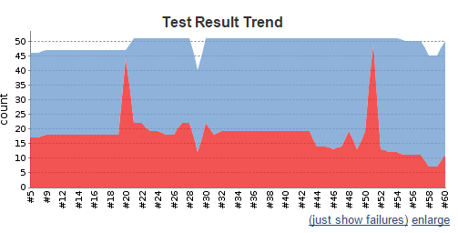
Track system health
Why do we need Continuous Integration?
Is your system healthy?
Notice bottlenecks quickly;
Find problems before they hit production.
Notes:
Jenkins gali parodyti Performance trends (pas mus pvz ir parodė)

Slide 11
Continuous Integration: best practices

Slide 12
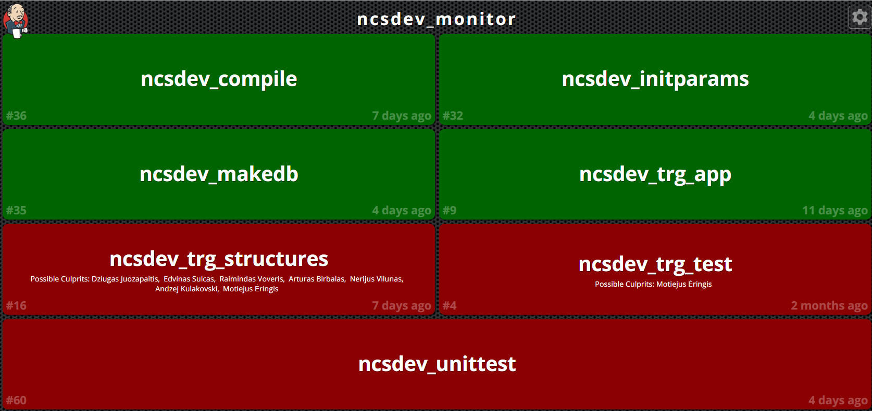
Continuous Integration: best practices
Commit often and with caution;
Keep an eye on status reports;
Fix failures as soon as they are noted;
Maintain your deployment process.
Notes:
Taisyklės, kurios gyvenimą vis tik palengvina ilguoja laikotarpiu.

Slide 13
Do it yourself: DEMO

Slide 14
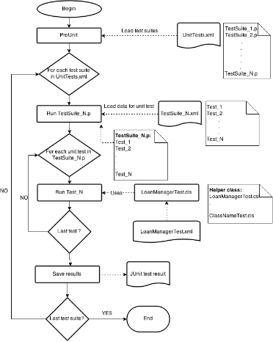
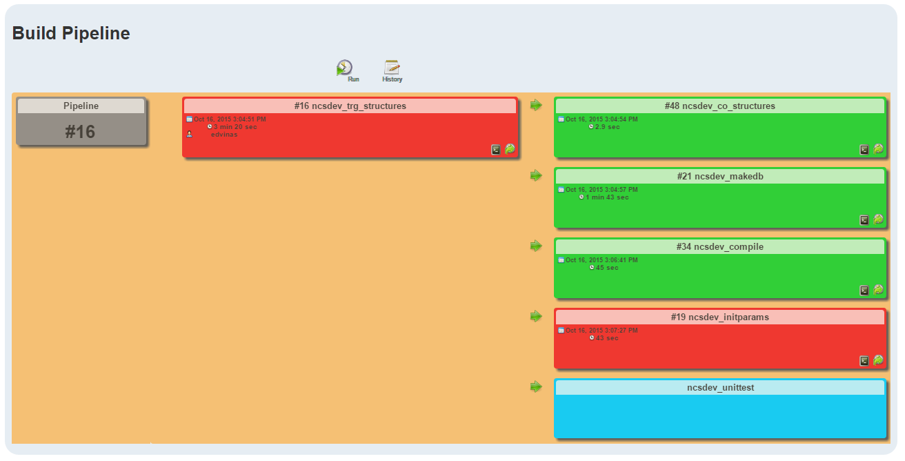
Our scenario
Update SVN
Compile
Steps based upon cases
Build DB
Initialize structures
Run tests
Generate statistics
Deploy to different environments
Notes:
*Compile (verify bad commits)*Build DB (verify bad structure)**Documentation?*initParams - create structure for the system*run tests, generate info*deploy to environments

Slide 15
Demo scenario
Update svn
Compile
Run tests
Generate statistics

Slide 16






Tools needed
Jenkins
Apache Tomcat
Version control
Apache ANT
PCT (Progress Compile Tool)
Unit testing framework
Notes:
Paminėti, kad viskas yr free
*TODO: urls?

Slide 17

DEMO
Let‘s see how it looks in action

Slide 18
What‘s next?

Slide 19
What‘s next?
Modify this setup to work for you
This solution is very scalable: add what you need;
Database backup/restore for autotesting;
Mock outside services;
Improve process
Which classes to compile?
When to restart AppServer?
Maintain your setup;
Adhere to best practices

Slide 20
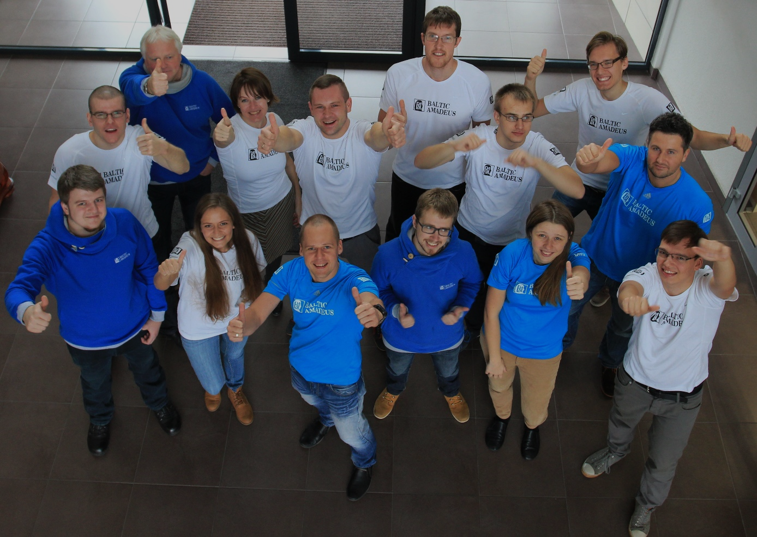
Link to instruction: https://github.com/BalticAmadeus/EmeaPug2015
Contact for question: e.sulcas@ba.lt
Make PROGRESS & #enjoyIT

